Slide 1
Extendable Desktop Search
Extendable Desktop Search
K.Vineel Kumar Reddy

Slide 2
Extendable Desktop Search
Desktop search: It is a tool which searches the content of user’s
files, web browser histories, text documents,
Audio files, images and video.
Objective
Nowadays with the increase in the size of hard disc, locating a file or
useful information in the system has become a tedious task , making
traditional searching process a futile exercise.
To address this problem we are going for desktop search.
One of the main advantages of desktop search program is that search
results come up almost Instantaneously

Slide 3
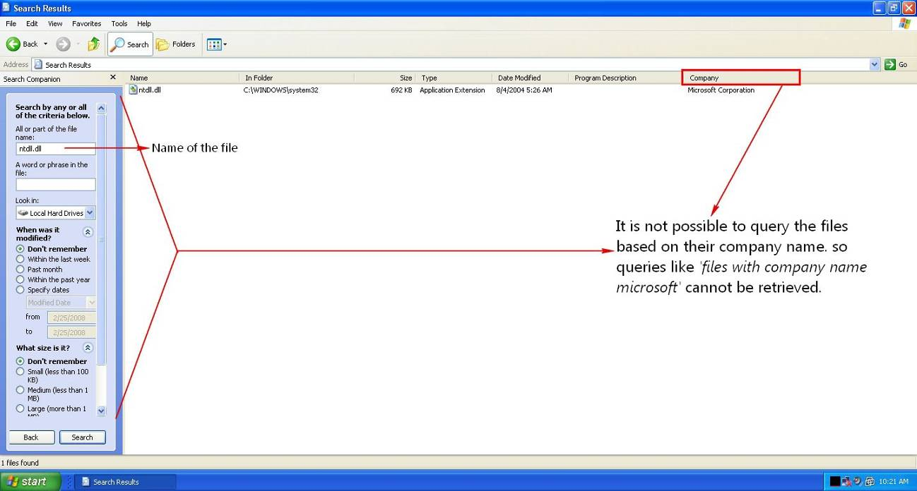
Limitations of windows search
1. There is no way to query files based on their company name

Slide 4
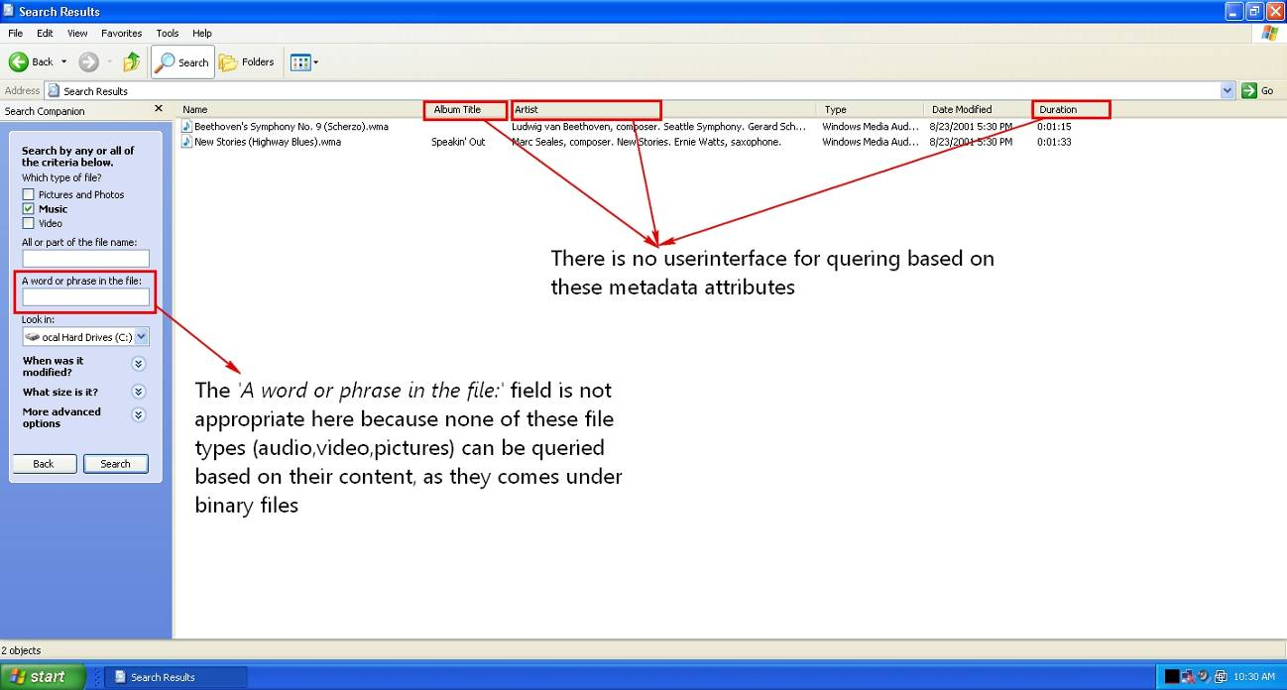
Limitations of windows search
2. Does not provide proper User Interface for querying
multimedia files based on their metadata attributes
-- Inconsistent User Interface

Slide 5
Limitations of windows search
3. Windows search cannot process commonly used compressed
formats like rar,tar,bz2,gz (it can handle only zip format)
4. It has no option for extending its capabilities with 3rd party add-ons.
--- Absence of extensibility mechanism.
5. Windows Search is based on traditional on demand file system
scanning mechanism, As a reason it is not usable if the size of
the hard disc is reasonably large.

Slide 6
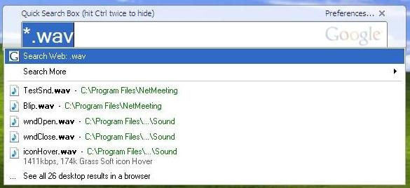
Limitations of Google Desktop Search
No user interface for specifying content based search vs.
file name based search

Slide 7
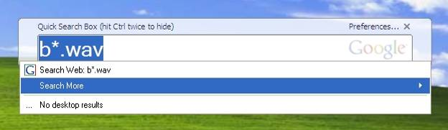
Limitations of Google Desktop Search
2. It cannot handle queries like “all wav files starting with letter ‘b’ “.
To our surprise when we pose such a query it results no files. (even
though there exists file with name ‘blip.wav’ – in the above slide)
3. It lacks support for Regular Expressions.

Slide 8
Extendable Desktop Search
Extendable Desktop Search(EDS) Vs other desktop search applications
Features | EDS | Windows | Google
Querying Metadata attributes | Yes | No | Yes
Regular expression support | Yes | No | No
Instantaneous Query Results | Yes | No | Yes
Extendable with new file parsers | Yes | No | Partial
Querying archive file contents | Yes | Partial | Yes
Windows Explorer Integration | Yes | Yes | No
Editing the tags of audio files | Yes | No | No
Query Emails from a pop3 server | Yes | No | No
Query based on Content vs. file name | Yes | Partial | Partial

Slide 9
Extendable Desktop Search
1. To provide results instantaneously, we are going for Indexing
2. Indexing is the process of parsing and storing the data to
facilitate fast and accurate information retrieval.
3. It indexes the contents of documents like doc, pdf, etc and
metadata attributes of audio and video files.
4. It Integrates seamlessly with windows explorer

Slide 10
Minimum Requirements for Extendable Desktop Search
Hardware Requirements:
Processor: Intel 1.6GHz
Memory: 256MB
Hard Disc: 10MB
Software Requirements:
OS: Windows NT(2000,XP)
Framework: .NET 2.0

Slide 11
Design and Implementation of Extendable Desktop Search
Technology Used
1. .NET is cross language interoperable – which facilitates 3rd parties
to write file parsers in any .NET aware languages (VB.NET,VC++.NET)
2. .NET provides better integration support to windows operating
system like access to windows registry, creating background
processes(scanning files for indexing ) etc
Implementation Language
C# is chosen as the language of implementation because of its
strong support for component oriented programming paradigms
and versioning capabilities.

Slide 12
Software Modules in Extendable Desktop Search
Software Modules
Indexing Module
Content Parsers Module
File System Monitoring Module
File System Crawler Module
Query Builder Module

Slide 13
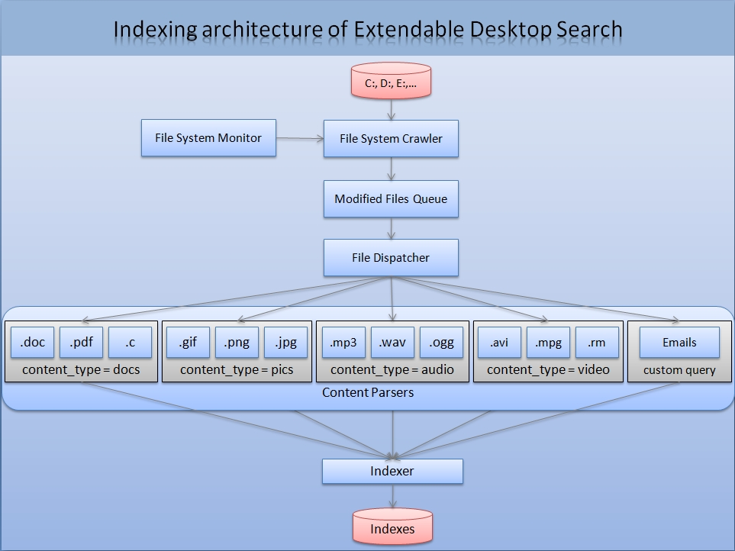

Slide 14
Data Flow diagram of Extendable Desktop Search
User activity flow between the modules
Process query by Query engine
Process Results
User chooses suitable UI
Enter the query by using GUI options
Display Results
Indexes
Files to be indexed
Content parser
Indexer
System Boot
File System Crawler
C:, D:, E:,…
File Monitor
Data flow between internal system modules

Slide 15
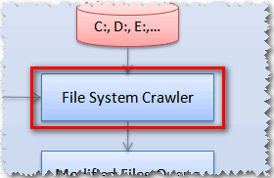
Software Modules in Extendable Desktop Search
File System Crawler Module
It will scan the hard disc at regular intervals to collect the files
that need to be indexed and invokes the indexer to index them
This module is designed to calculate the CPU’s idle time to
schedule itself for the next scan.

Slide 16
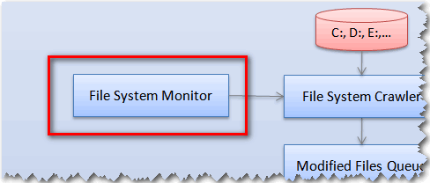
Software Modules in Extendable Desktop Search
File System Monitoring Module
1. It looks after the file system changes that have occurred due to
creation, deletion, updating of files by the user.
It will also monitor the open files that are being used by the
currently running processes in the system, as these files are more
likely to be modified (a file opened in notepad has more chance
of getting modified than the files not opened by any process).

Slide 17
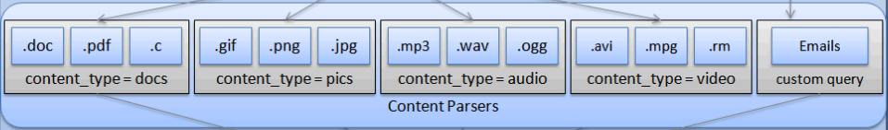
Software Modules in Extendable Desktop Search
Content Parser Module
This comprises of various parsers that can handle (parse) their
respective file types.
2. The input to this module is a file (parser specific) and the output is
textual content, which will be fed as an input to the indexer.
3. For example, if the input to it is an audio file then the output will
be all metadata attributes like Album, Bit rate, composer etc

Slide 18
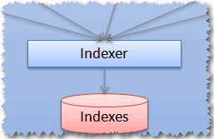
Software Modules in Extendable Desktop Search
Indexing Module
1. This is the core component responsible for indexing the contents of
major document formats (.doc, .pdf), metadata attributes of audio
and other binary file formats.
2. It will intelligently assign a ranking factor to the indexed files,
based on the number of times the file got updated/read.
3. It filters unnecessary linguistic words (an, the, in etc) from
being indexed by using Analyzers, this greatly reduces the size
of the indexes.

Slide 19
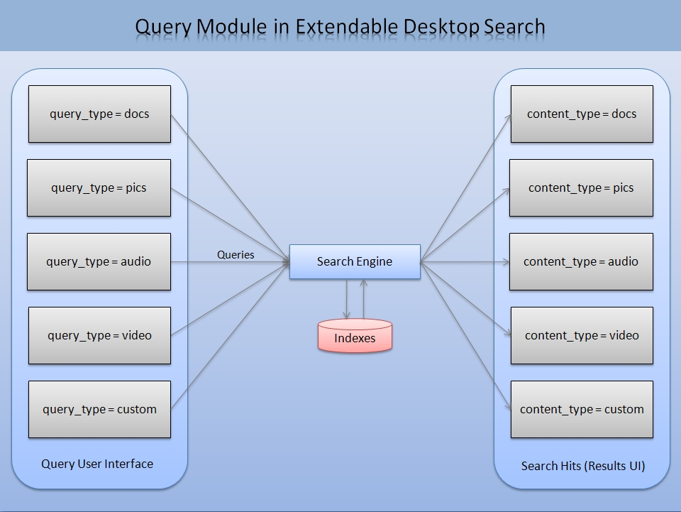
Software Modules in Extendable Desktop Search
Query Engine Module
This module is the information retrieval component of the software.
The input to this module is a query, which will be given by the user
by selecting various options in the GUI.
The given query is analyzed by this module and fetches the results
from the indexes according to their ranking

Slide 20
User Interface of Extendable Desktop Search
Extendable desktop search provides user interface for following
content types
Documents
Pictures
Audio
Video

Slide 21
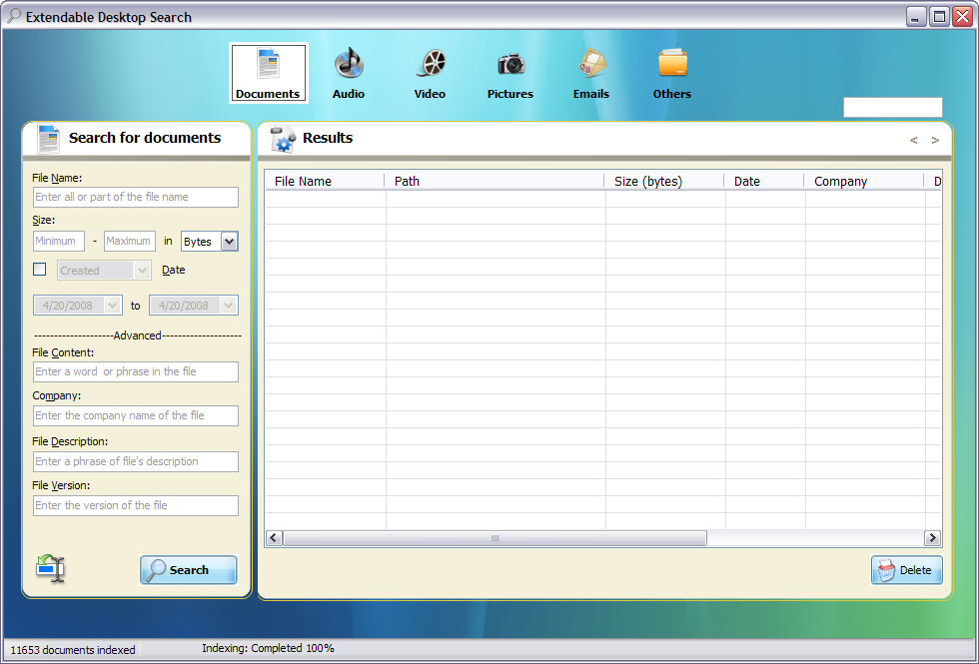
User Interface of Extendable Desktop Search
Documents
This interface provides the user for searching files based on following
properties
File Name
Size
Type
Date
Content
Company
Description
Version

Slide 22
User Interface of Extendable Desktop Search
The important property of this interface is the Content property,
this field is responsible for querying the documents based
on their contents.
The application can handle following documents formats.
Microsoft Word Documents(doc)
Adobe Portable Document Format(pdf)
Web Documents (Html, Htm )
Compressed Files(rar,zip,gzip,bz2)

Slide 23
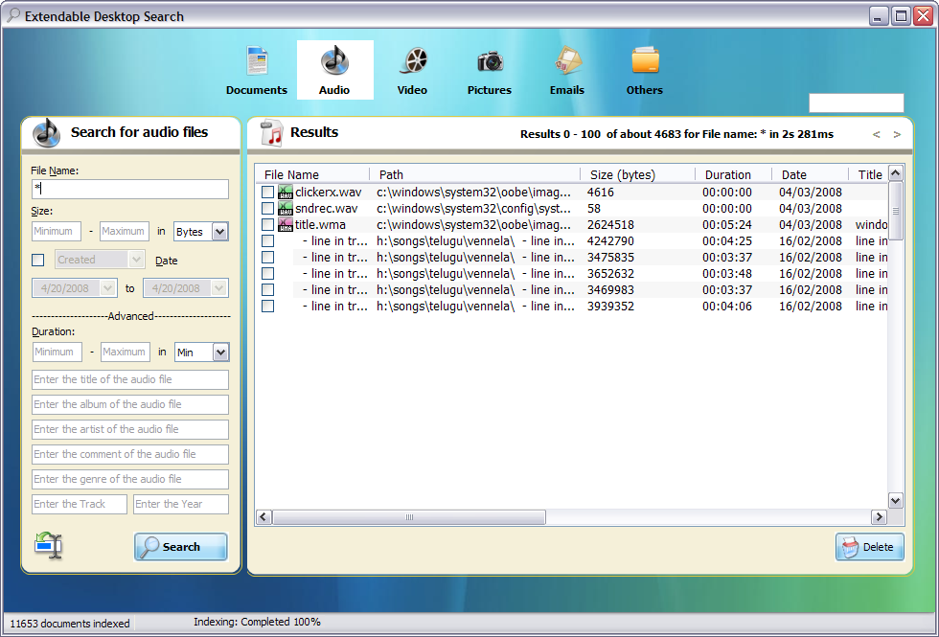
User Interface of Extendable Desktop Search
Audio and Video
This interface provides the user for searching audio files base on
following properties
File Name
Size
Date
Duration
Title
Artist
Album
Genre

Slide 24
User Interface of Extendable Desktop Search
This interface gives the user full control in searching audio and
video files based on various metadata properties.
The application can handle following audio and video formats.
MPEG Layer-3 (mp3)
Waveform audio (wav)
Ogg Vorbis (ogg)
Windows Media Audio (wma)
Audio Video Interleave (avi)
MPEG-4 (mp4)
Windows Media Video (wmv)

Slide 25
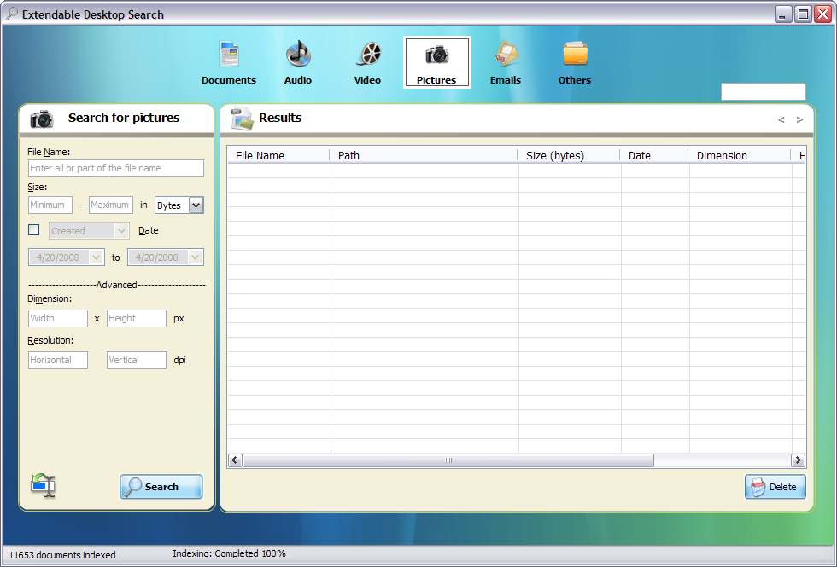
User Interface of Extendable Desktop Search
Pictures
This interface provides the user for searching image files based on
following properties
File Name
Size
Date
Type
Dimension
Resolution

Slide 26
User Interface of Extendable Desktop Search
Dimension field is responsible for querying the images based
on their Dimension (Height, Width).
Resolution field is responsible for querying the images based
on its resolution (both horizontal and vertical)
The application can handle following image formats.
Bitmap (bmp)
Graphics Interchange Format(gif)
Joint Photographic Experts Group Format(jpeg)
Portable Network Graphics (png)
Tag Image File Format (tiff)
Exchangeable Image File(exif)

Slide 27
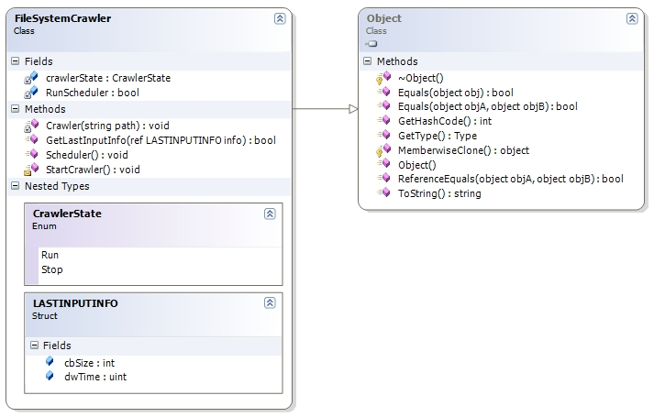
Implementation of File System Crawler
This module will perform a sequential file system scan for the files
that need to be indexed
The built-in scheduler monitors the system resources and
accordingly starts the crawler based on the availability of resources

Slide 28
Flowchart of File System Crawler
Start
Enumerate all the volumes that need to be crawled
2
Create an instance of the indexer
Invoke the indexer with the metadata attributes as input
1
Perform a tree traversal on the volume that need to be crawled
1
Stop
No
Is File
Yes
Analyze the extension and invoke the appropriate parser to extract the metadata attributes
2

Slide 29
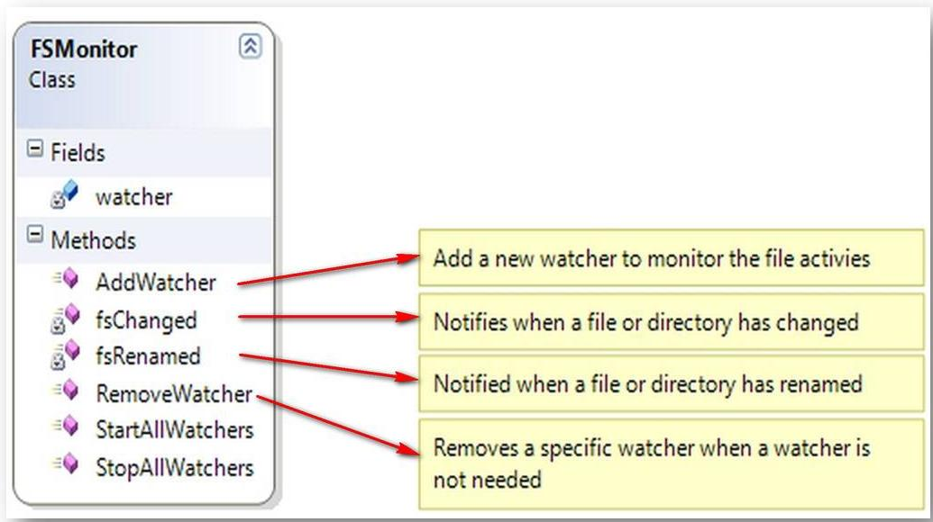
Implementation of File System Monitor
It contains a list of monitors whose activities should be analyzed.
Each FileSystemWatcher monitors the file system activities and
captures file delete, create, change and rename events.
3. Finally the path to the event and the operation type is stored in
create, rename, delete lists

Slide 30
Flowchart of File System Monitor
Start
Register the volumes to be notified for FS activities
Handle each notification with its own delegate method
Filter the data to obtain the relevant information
Deleted
Notification Type
Created
Add the file path to ‘create queue’ list
Renamed
Add the file path to ‘rename queue’ list
Check whether the deleted file is in create queue
Delete the file path from ‘create queue’ list
Yes
No
Add the file path to ‘delete queue’ list
Stop

Slide 31
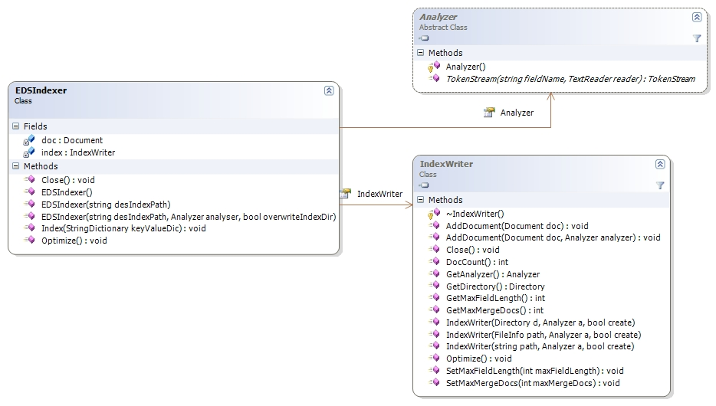
Implementation of Indexer
Indexer stores the given Key, Value properties in an optimized form
by using Analyzers
Analyzers know how to filter the fillers like ‘the’, ’is’, ’an’ etc from
the input values

Slide 32
Flowchart of Indexer
Start
Instantiate the indexer object
Call the Index method of indexer object with parameter as a dictionary holding the key, value pairs of the document
1
Close the indexer
Read the next key from the dictionary data structure
No
Stop
if key == “content”
Yes
Use necessary analyzer
No
Store the value
Yes
Has more Keys
No
1

Slide 33
Implementation of Extendable Desktop Search
Supports Plug-in framework for parsing new file types
To be able to accept a class as a file parser, it should have
implemented the interface IEDSParser
Every parser should be able the parse the input content and
return the results back to the caller in a list containing
KEY, VALUE pairs

Slide 34
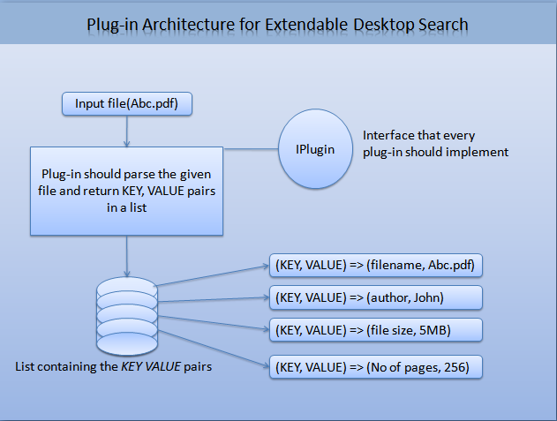
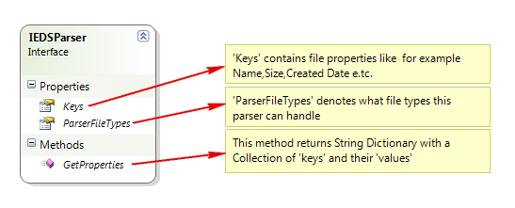
Implementation of Extendable Desktop Search

Slide 35
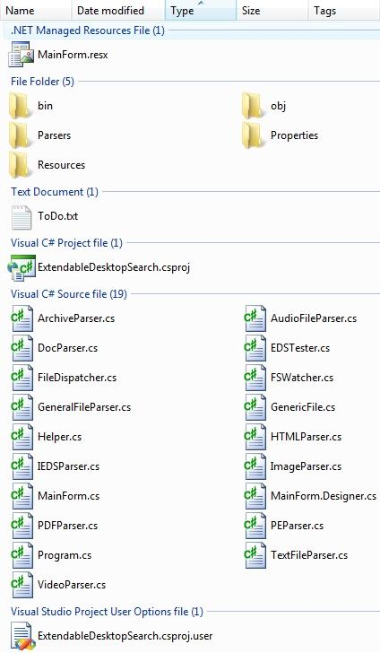
Implementation of Generic File Parser
Every file have some basic properties.
In the figure the column headers denote the basic properties of the files.
Name => Name of the file
Date modified => Updated file date
Type => File type
Size => File size in bytes
We encapsulated this behavior in a base class named GenericFile -- It deals only with the above basic properties.

Slide 36
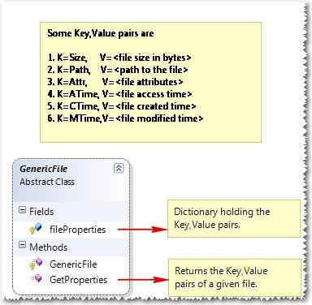
Implementation of Generic File Parser

Slide 37
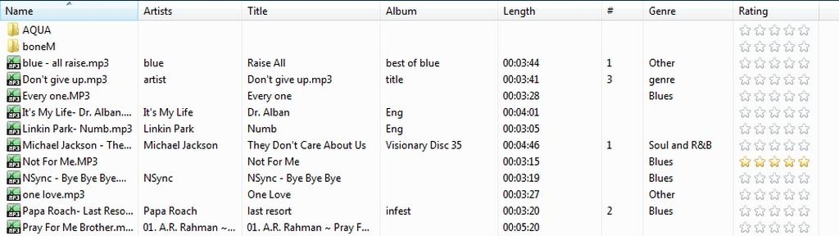
Implementation of Audio File Parser
Along with these basic properties each file type has its own specific properties
For example if we consider audio files the following are the extra properties
Artists => denotes the artists of the song
Title => denotes the Title of the song
Album => denotes the Album of the song
Length => denotes the duration of the song
We encapsulated this behavior in a class named AudioFileParser which extends GenericFile , It also implements IEDSParser to provide a consistent interface for very file parser

Slide 38
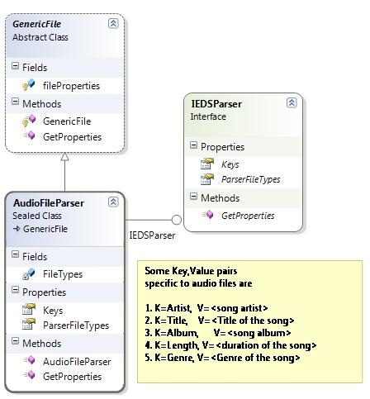
Implementation of Audio File Parser

Slide 39
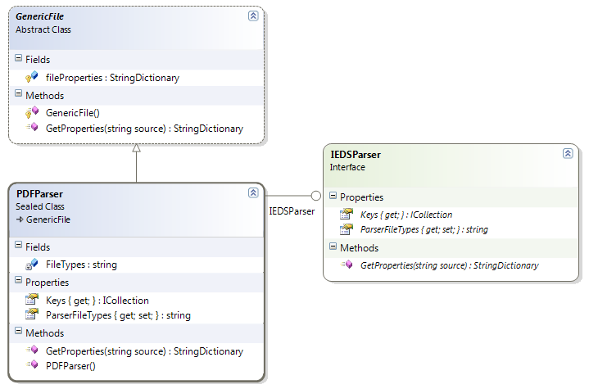
Class Diagram of PDF Parser(implementation of EDS parser interface)

Slide 40
Flowchart of PDF Parser
Start
Open pdf
Read pdf
End of File
Stop
Yes
No
No
Find BT
Read Text Until ET is encountered
Yes
Decompress the ‘Text Object’ to plain text using zlib compression library
Output the plain text

Slide 41
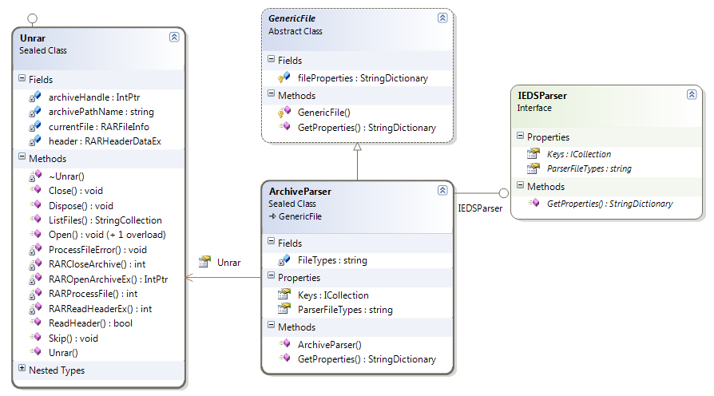
Class Diagram of Archive File Parser (implementation of EDS parser interface)

Slide 42
Flowchart of Archive File Parser
Start
Open archive file
Archive file
No
Handle only basic file properties
Yes
Archive Type
.rar file
.tar file
.bz2 file
.gz file
Rar Handler
Tar Handler
Bz2 Handler
Gz Handler
Return Dictionary object containing the properties of the archive file
Stop

Slide 43
Advantages of Extendable Desktop Search
Indexing process is completely transparent to the user
Automatically schedules itself to system inactivity periods
Supports well defined plug-in framework, to enhance its capabilities by 3rd parties
Less CPU(works with 1.6GHz ) and Memory (uses < 30MB) consumption

Slide 44
Extendable Desktop Search
Queries ?

Slide 45
Extendable Desktop Search
Thank You

